Slide 1
REALISTIC FACE IMAGE GENERATION BASED ON GENERATIVE ADVERSARIAL NETWORK

Slide 2
Introduction
Using computer to generate images with realistic images is one of the trending topic in computer vision research.
So mainly we need to generate realistic face in order to increase the face recognition dataset, which in return helps the face recognition algorithms to work better.
In this Paper they had proposed a new methodology using GAN for generating artificial images based on a real image in the data set.
The proposed model is obtained by using Deep Convolution Neural Network and Deep convolution Transpose network

Slide 3
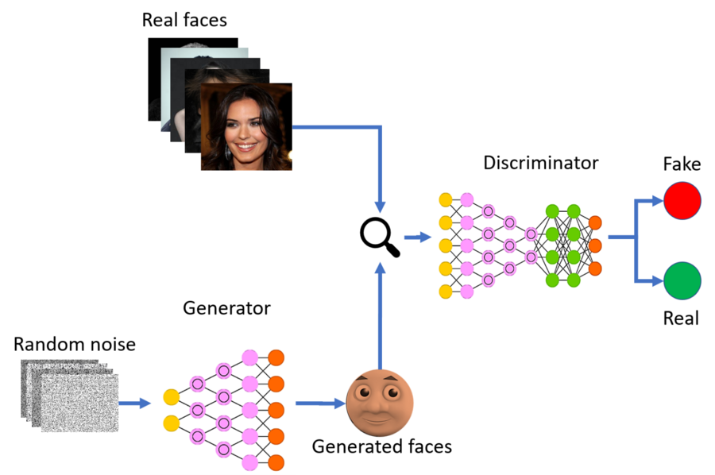

Slide 4
Method Proposed
The proposed method have two different parts, Generator and a Discriminator
-> Generator in the model is responsible for creating a artificial images based on the given input image
-> And the Discriminator attempts to distinguish between the real sample and the output from the generator.
The goal is to generate samples as good as real samples; the discriminant model D is one the classifier that estimates the probability of deriving the samples from the training data (rather than the generated data). If the sample is from real training data, D outputs a large probability; otherwise, D outputs a small probability.

Slide 5
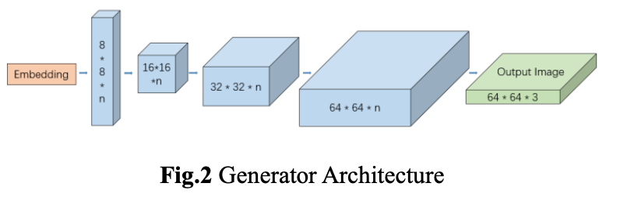
Generator G: We use the same architecture as the discriminator decoder, but with different weights. The first layer receives the random noise signal vector for the fully connected layer, and is multiplied by the weight matrix to be transform into a three-dimensional tensor; the remaining layers are deconvolution operation layers, and 2×2 strides are used in the deconvolution operation. The Relu activation function is used, the last deconvolution layer uses the tanh activation function to generate a three-channel image.

Slide 6
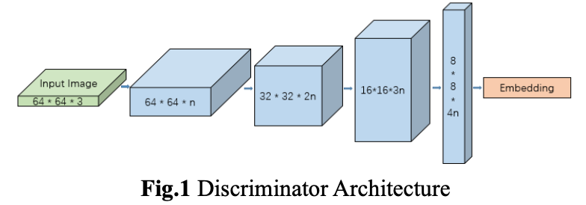
Discriminator D: We use an auto-encoder with a depth encoder and decoder. We use two convolutions per layer. At each subsampled, the convolution filter is linearly increased, achieve subsampling with stride of two, and do up sampling by nearest neighbors. The discriminator receives the three- channel image, obtains the feature map after multiple convolution operations, maps it to a scalar value after deforming it into a vector, and uses the Sigmoid function to determine the loss function value of the discriminator

Slide 7
Experiments and Setup
Here we have performed our model on The CelebA Face Dataset is the open data, which contains 202,599 face images of 10,177 celebrity identities, all of which have been feature-marked, which is a very useful dataset for face-related experiments.
We train and test our model on the CelebA dataset and compare them with the other existing models classic DCGAN and WGAN architecture
The initial learning rate is given to 0.0001and performed on 2000 iterations.

Slide 8
Here we use Wasserstein Distance as a parameter to define our loss function
We have two loss functions Generator loss function and Discriminator loss function.
Goal of Discriminator would always increase the distance between two images, where as the Generator goal is to minimize it.

Slide 9
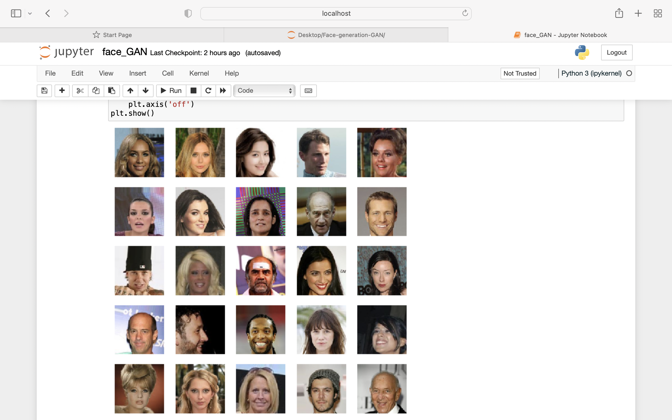

Slide 10
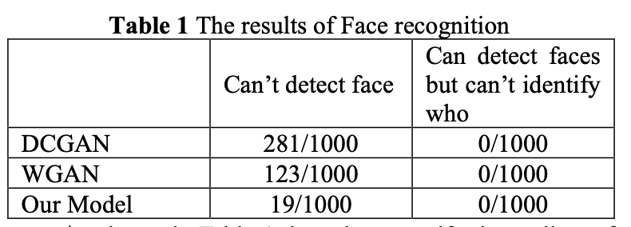

Slide 11
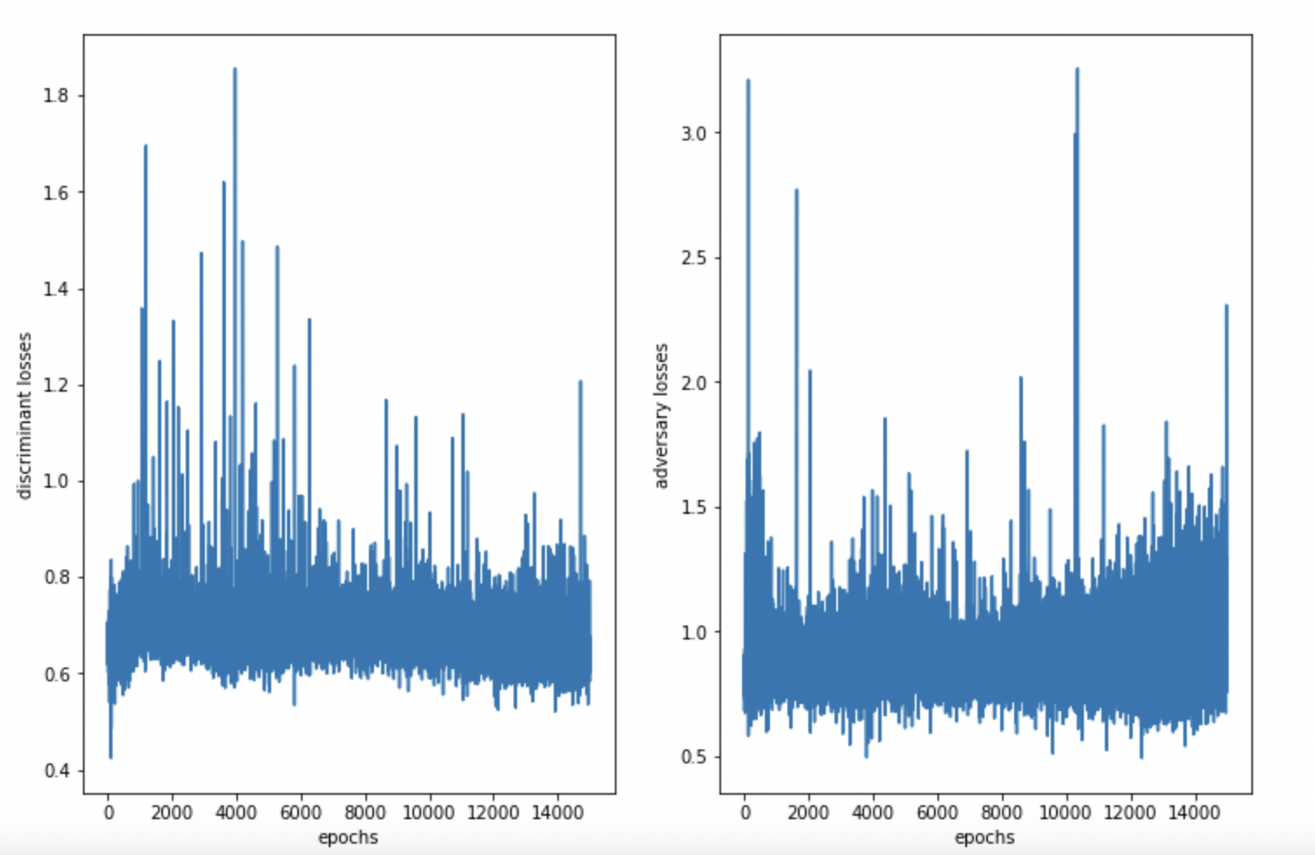

Slide 12
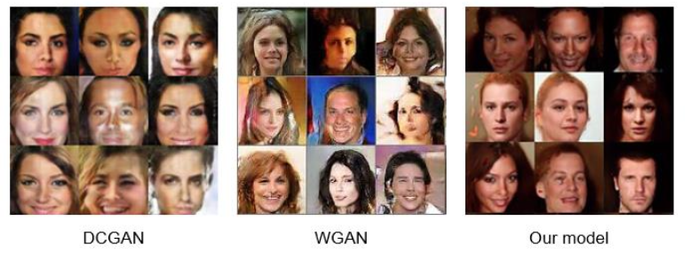
Results:

Slide 13
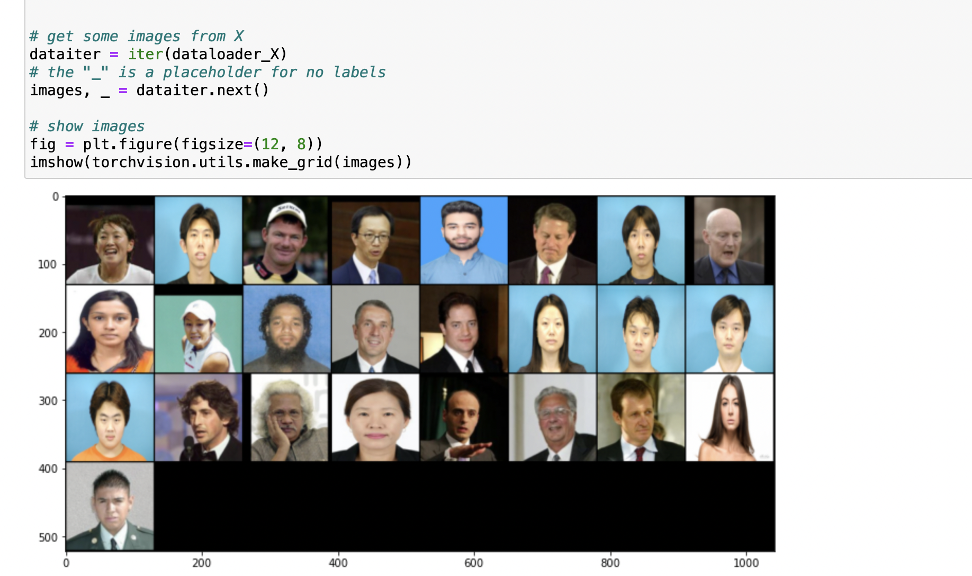
Further Implements:
We have used this model to and work it on Sketch data, and tried to convert sketch images to real images

Slide 14
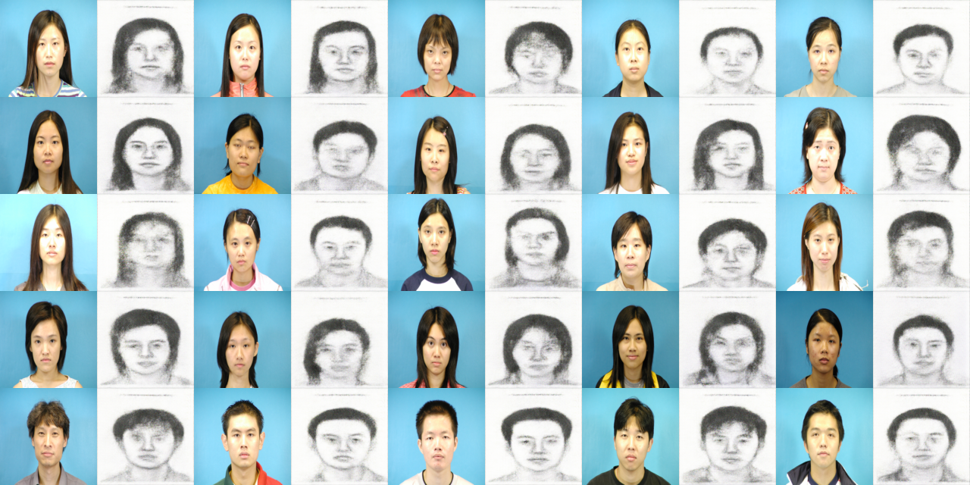
Output:

Slide 15
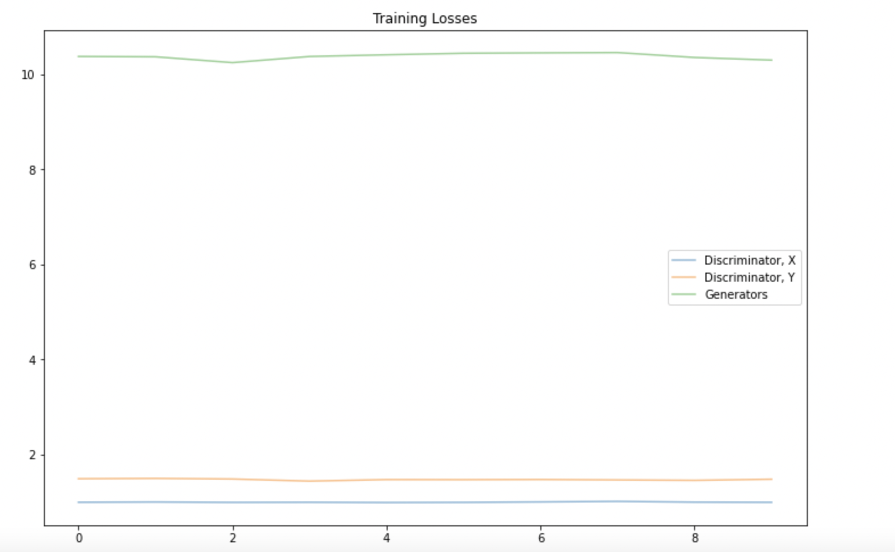
Loss Graph for our Implementation:

Slide 16
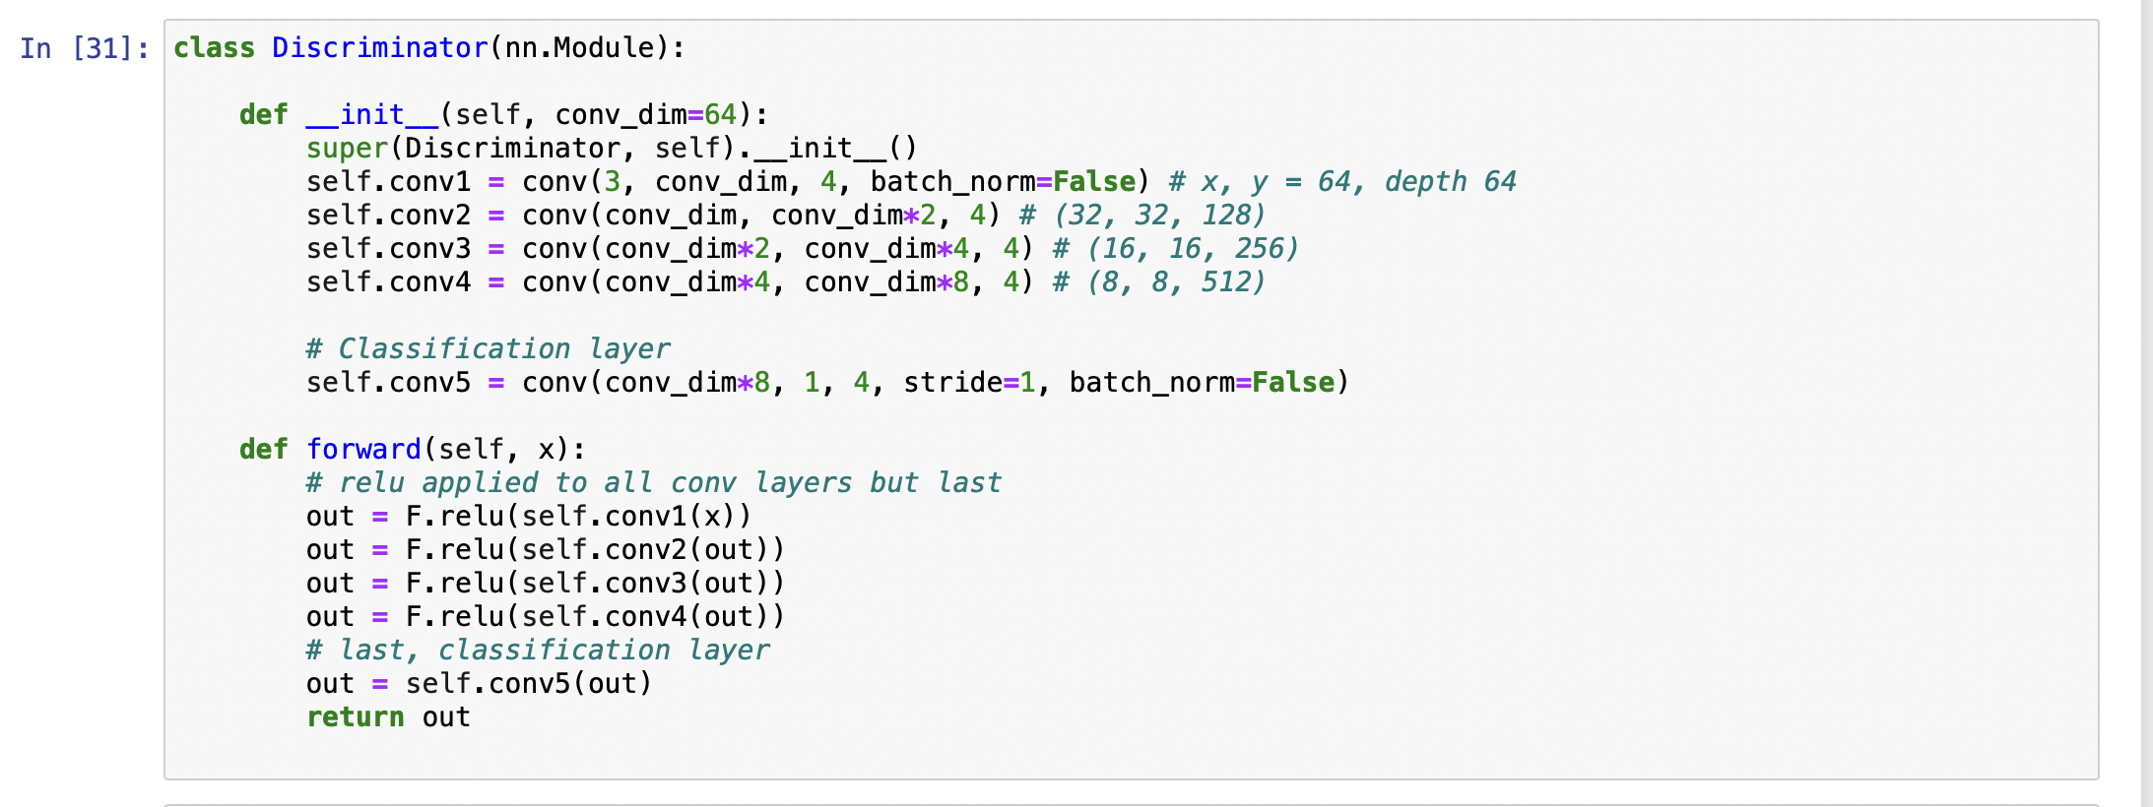

Slide 17
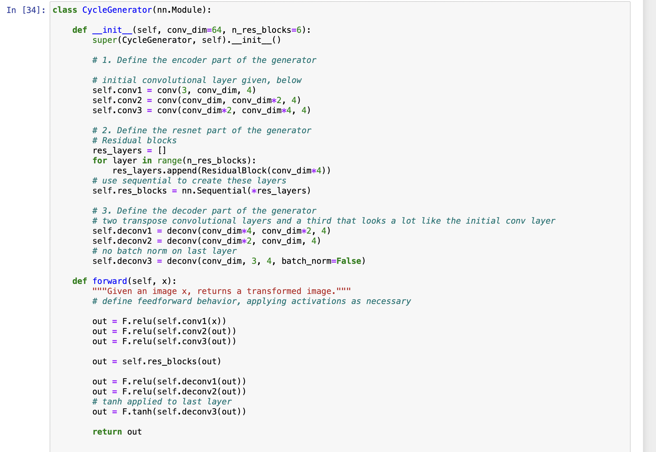

Slide 18
Thanks!
ANY QUESTIONS?

